Slide 1
The Economics of Low Carbon Transformation
new theories, approaches and policies
Michael Grubb
Research Director and Professor Energy and Climate Change,
University College London (UCL) – Inst. Sustainable Resources & Energy Institute
Convening Lead Author, Intergovernmental Panel on Climate Change (IPCC) Mitigation Report Ch.1
UCL Public Lecture series on Policy and Practice
UCL Department of Economics / Department of Political Science / School of Public Policy
5th December 2019

Slide 2
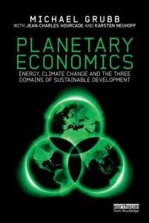
The Economics of Low Carbon Transformation
Preface: science perspectives on climate risks
Part 1: The Stylised global economics of climate change
The standard model and critiques
An unconventional critique
The components of dynamic realism
Inertia
Induced Innovation
Path Dependence
Formalisation and Results
Part 2: Innovation, transformation and UK’s next frontier
Energy, Climate Change and the Three Domains of Sustainable Development
@michaelgrubb9

Slide 3
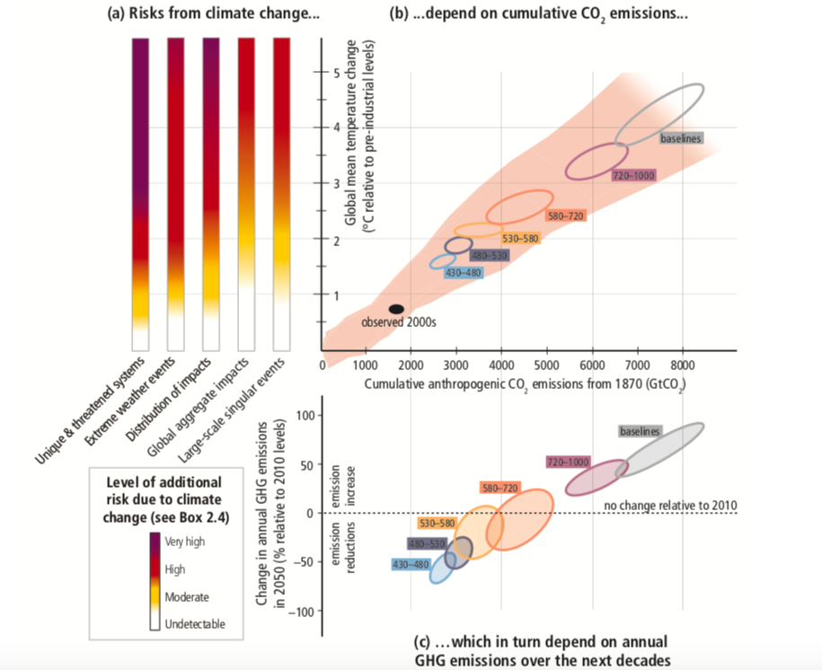
‘Avoid Dangerous Anthropogenic Interference’ (UNFCCC)
Interpreted under the Paris Agreement to mean aiming for
“well below 2 deg.C and pursue efforts towards 1.5 deg.C”
- not more than another c. 1000 Gt = 25 years @ 40GtCO₂/yr

Slide 4
Emission pathways consistent with the Paris Agreement
“well below 2 deg.C and pursue efforts towards 1.5 deg.C”
Sharp descent, to more than halve global CO2 by 2050 and continue to ‘net zero’
Source: Huppmann, D. et al. (2018) A new scenario resource for integrated 1.5°C research.
4

Slide 5
The Economics of Low Carbon Transformation
Preface: science perspectives on climate risks
Part 1: The Stylised global economics of climate change
The standard model and critiques
An unconventional critique
The components of dynamic realism
Inertia
Induced Innovation
Path Dependence
Results
Part 2: Innovation, transformation and UK’s next frontier
Energy, Climate Change and the Three Domains of Sustainable Development
@michaelgrubb9

Slide 6

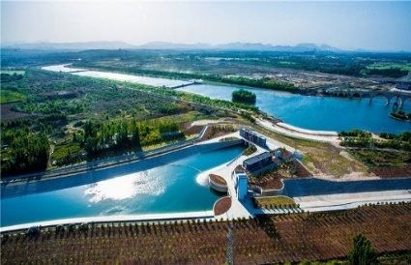

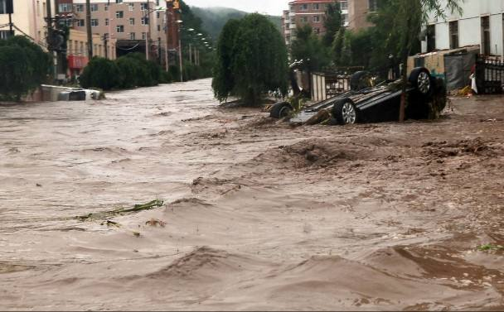
The costs and benefits of curbing emissions
Atmosphere concentrate → Forcing increase → Average Temperature increase
Economic development is accompanied by CO₂ emissions
Extreme weather, ocean impacts etc
Imposing damages,
need adaptation investments,
national disaster relief, migration… ?
With thanks to Pu Yang, UCL – Bartlett CPM
Now
Future

Slide 7
…. seeks to balance abatement costs and climate benefits
The Economic Approach to “Integrated Assessment …”
Balance
Climate Benefits
(benefits of avoided climate damages)
Abatement Costs
(cost of cutting emissions)
Business as usual emissions
Cost
Benefit
Emissions
Damages
Abatement path?
Time
Time

Slide 8
Nordhaus’ DICE model with his “standard“ assumptions
80 years to halve global emissions
10 years to halve again
…. Classical Computable General Equilibrium model, assumes globally perfect foresight with discounted damages. Attracted huge range of criticisms, for assumptions on
(In)equity assumptions, discount rate applied to future damages, Incomplete impacts, valuation of non-market welfare & ecosystem impacts, risk aversion …
…. On all of which, most studies (including by Nordhaus himself) concluded that changes would increase optimal abatement, perhaps hugely.

Slide 9
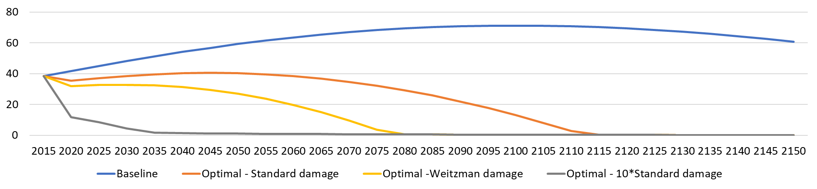
Sharply non-linear damages?
Nordhaus’ DICE model – any colour you like?
With thanks to Pu Yang, UCL – Bartlett CPM
…. Or just overall, dominated by “Known and Unknown Unknowns” – Pezzey (2018)
There is no identifiable upper bound to risk- and equity-adjusted climate damages

Slide 10
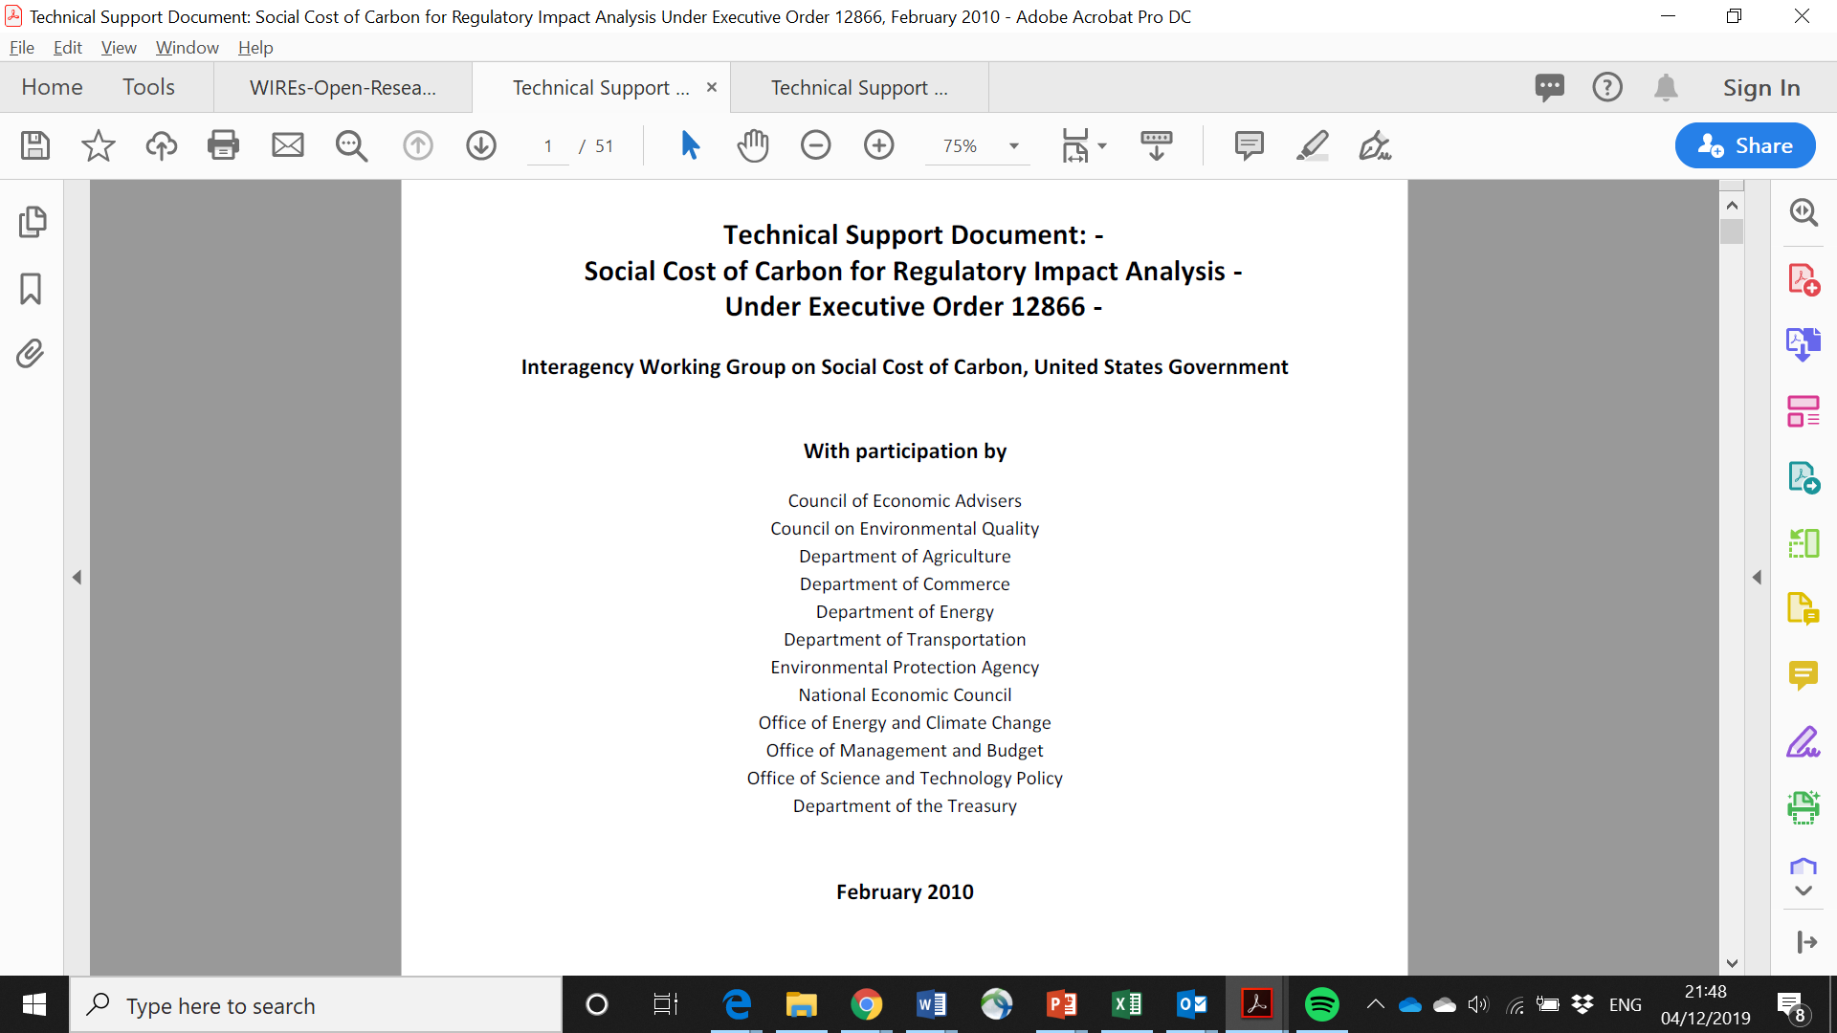
A weird world?
… and you may be right, but:
Economists always on a search for balancing costs and benefits
A legal requirement in US legislation
The InterAgency Task Force under Obama
Trump cancellation of the Obama Clean Power Plan, etc
UK Treasury seeks to use a ‘social cost of GHG emissions’, though evolved …

Slide 11
…. Has mostly neglected the other side of the ledger …
The Economic Approach in such models …
Abatement Costs
(cost of cutting emissions)
Cost at time t of reducing emissions at time t by µ, C(t) = f(µ(t))
Calculated abatement cost depends upon distance from assumed
‘BaU’ reference emissions path
“The usual terms & conditions apply” (eg. f(µ(t) monotonically rising, etc)
Business as usual emissions
In DICE:
Cost
Emissions
Abatement cost as fraction of global GDP = c_{A}(t) . μ(t) ^{θ}
Abatement path?
Now, Hang on a Moment and Reflect …
There is no History
Time

Slide 12
The fundamental challenge
The default assumption
Temporal Independence
Stylised ‘integrated assessment’ models with no relationship between abatement in one period and another
Three components of Dynamic Realism
Inertia
Induced Innovation
Path Dependence

Slide 13
The Economics of Low Carbon Transformation
Preface: science perspectives on climate risks
Part 1: The Stylised global economics of climate change
The standard model and critiques
An unconventional critique
The components of dynamic realism
Inertia
Induced Innovation
Path Dependence
Results
Part 2: Innovation, transformation and UK’s next frontier
Energy, Climate Change and the Three Domains of Sustainable Development
@michaelgrubb9

Slide 14
(a) Inertia – historical rates of change
Various timescales:
Lag from R&D to a few % can be decades
Energy technologies:
nuclear 20 years from 5 to 90%;
coal 35 years from 5 to 90%
Consumer adoption, wider range
of final penetration
Key infrastructures may be even slower (think cities, roads, buildings)
Low carbon transitions need to work with what exists
Whilst developing economies have better prospect to ‘leapfrog’
Also eg. costs of ‘stranded carbon assets’ and political resistance of incumbent interests

Slide 15
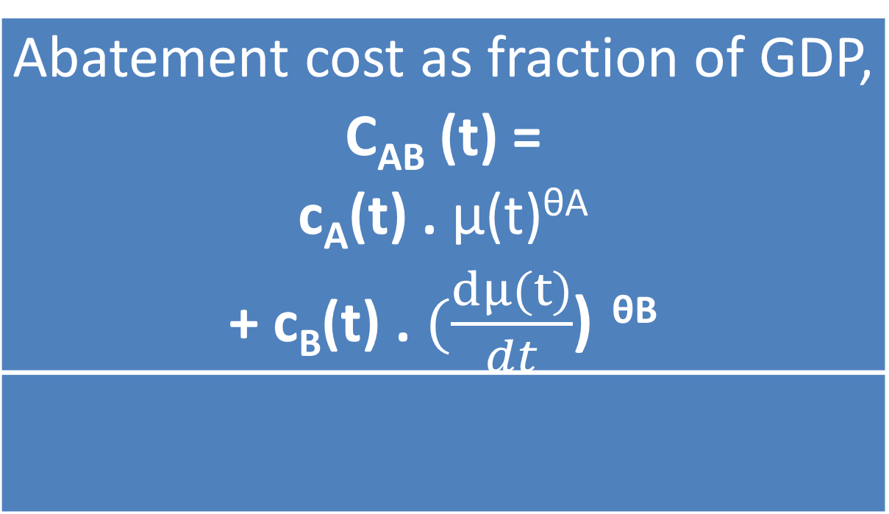
Adding Inertia is easy
Abatement cost as fraction of GDP, C_{AB} (t) = c_{A}(t) . μ(t)^{θA} + c_{B}(t) . $(\frac{dμ(t)}{dt}$) ^{θB}
Rigid costs (c_{A}) –
projected into the future, unaffected by our efforts
Transitional costs (c_{B}) – associated with the rate of change away from ‘BaU’
But have we done anything, other than make the task more difficult?

Slide 16
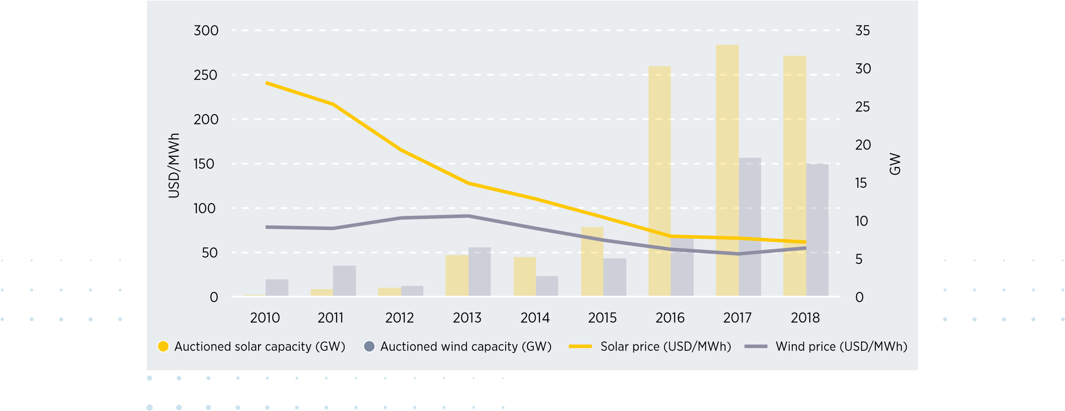
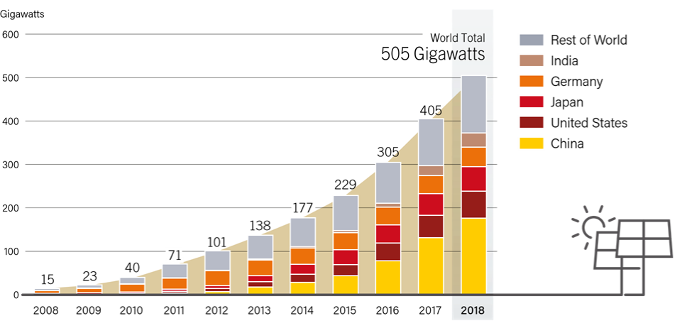
(b) Induced innovation – example,the Solar Revolution
“Solar power is by far the most expensive way of reducing carbon emissions - The Economist, 2014.
“.. in Germany, like growing pineapples in Alaska.” - J. Grossmann, then CEO of RWE, 2012
Source: IRENA (2019), Renewable Energy Auctions: Status and Trends Beyond Price
Global average prices resulting from auctions, 2010-18
Solar: From 15 to 500 GW in a decade
Auctions in summer 2019 broke three times the world record of cheapest solar PV tariff:
Los Angeles, USA - $20/MWh
Brazil - $17.5/MWh
Portugal - $16/MWh
Portugal’s July 2019 world’s cheapest PV.
Ethiopia Sept 2019, Africa’s cheaper PV to date @ $25/MWh
Actually, emerging as the cheapest widespread high-grade energy source in human history
Notes:
18-12 Delhi CPR Conf – global energy context

Slide 17
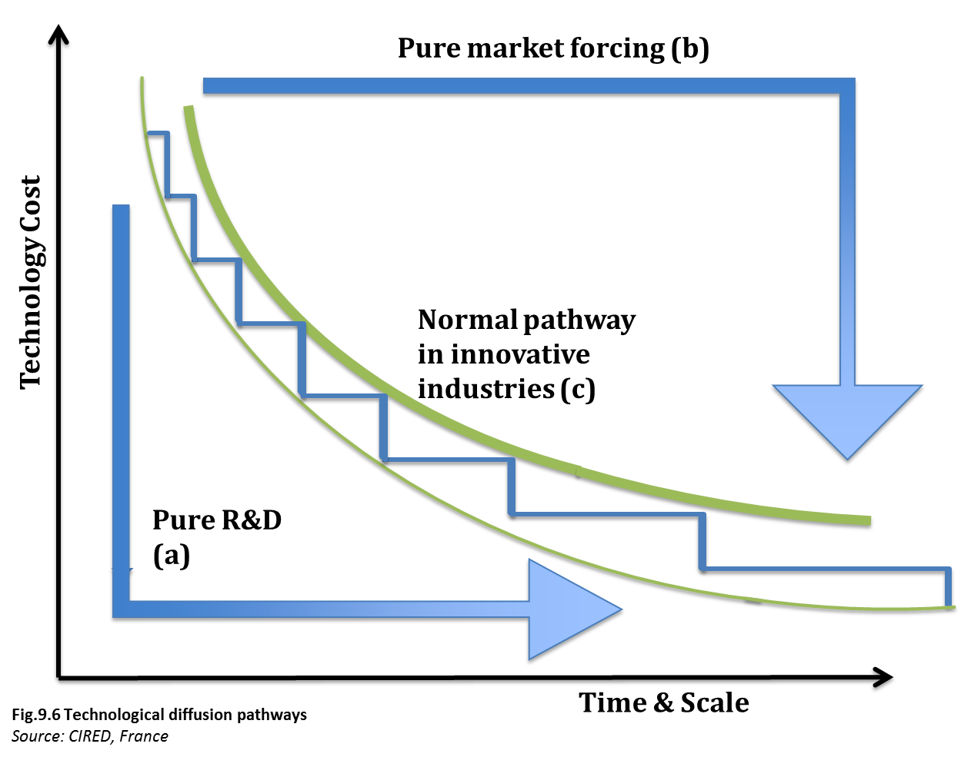
Technology costs decline with both time and investment
Learning, time and investment are interrelated –
but has anyone mapped out how?
… The reality is that most technologies have to evolve through repeated cycles of market growth, learning, scale economies and supply chain development

Slide 18
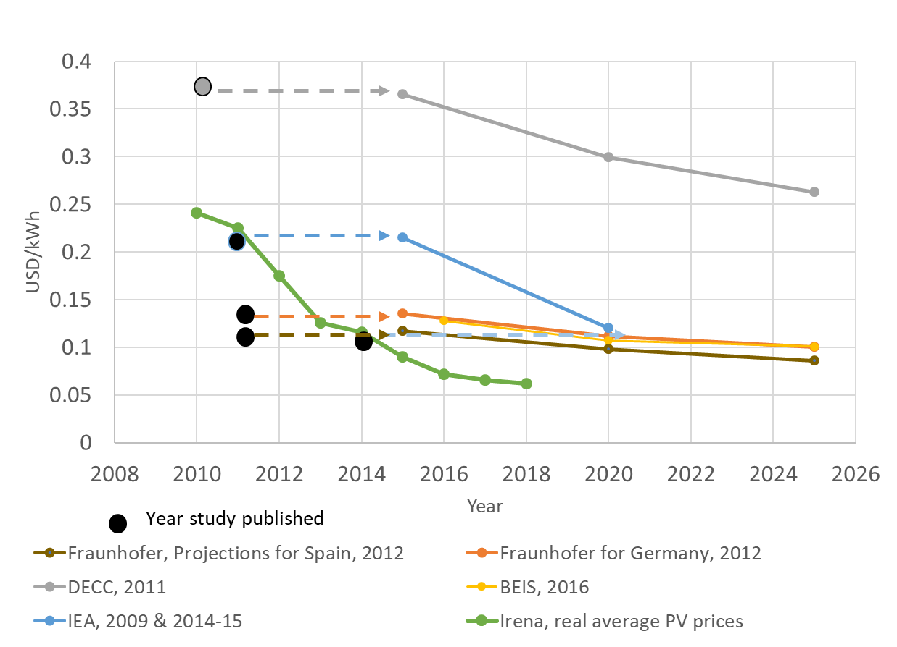
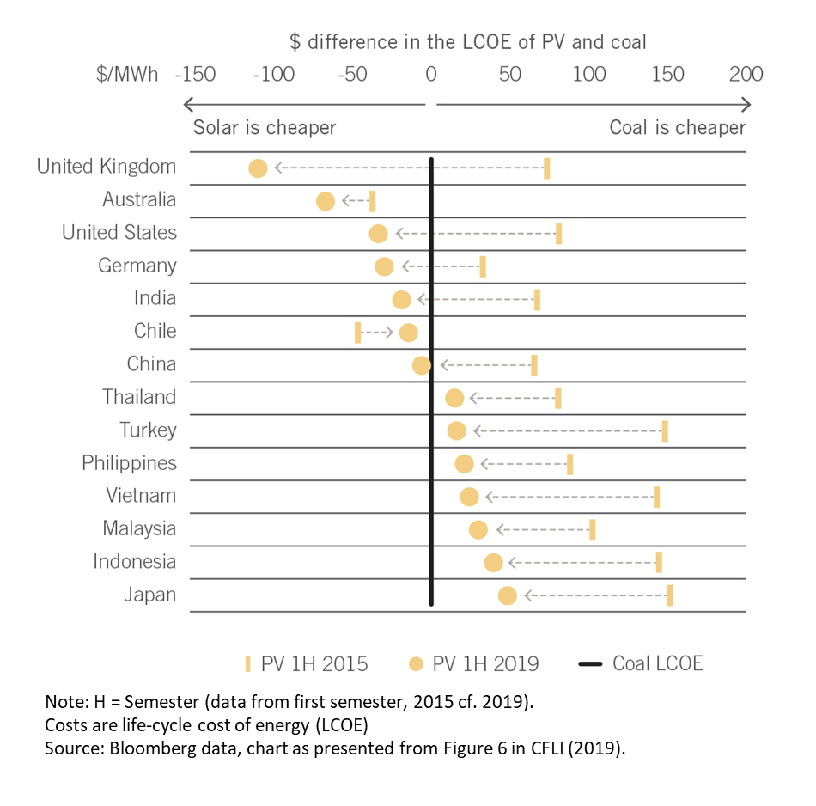
Innovation – dramatic changes, far faster than projected
Projections for levelized cost of energy for large-scale solar PV vs realised global average prices from auctions
Evolution of the relative life-cycle cost of new solar PV and coal plants, 2015-2019 – local learning and efficient policy important
Source: Authors, from data sources as shown

Slide 19
So maybe …
The Rigid (c_{A}) costs, as projected into the future, are actually much smaller than assumed?
That many of the costs are in fact transitional (c_{B}), associated with the buildup of new industries - and the decline of the old, and overcoming other rigidities?

Slide 20
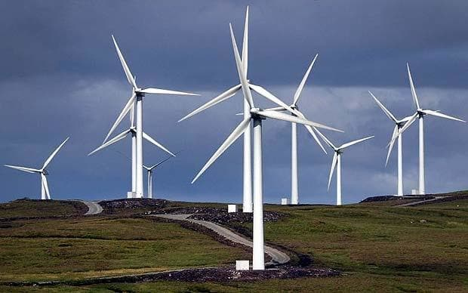
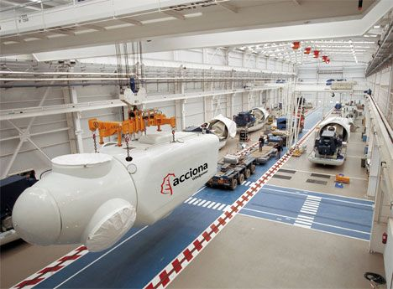
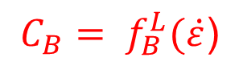
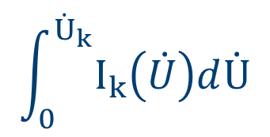
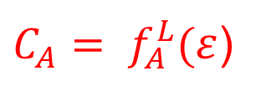
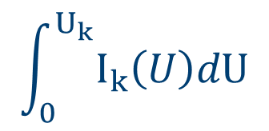
Conceptual components of abatement cost
To produce wind power, investment in wind turbines is required
... to produce wind turbines, investment in wind turbine factories is required
$$\int_{0}^{U_{k}}{I_{k}\left(U\right)dU}$$
$$\int_{0}^{{\dot{U}}_{k}}{I_{k}\left(\dot{U}\right)d\dot{U}}$$
$C_{A}= f_{A}^{L}(ε$)
$$C_{B}= f_{B}^{L}(\dot{ε}\text{)}$$
$ε$ represents the buildup of low carbon industries == µ

Slide 21
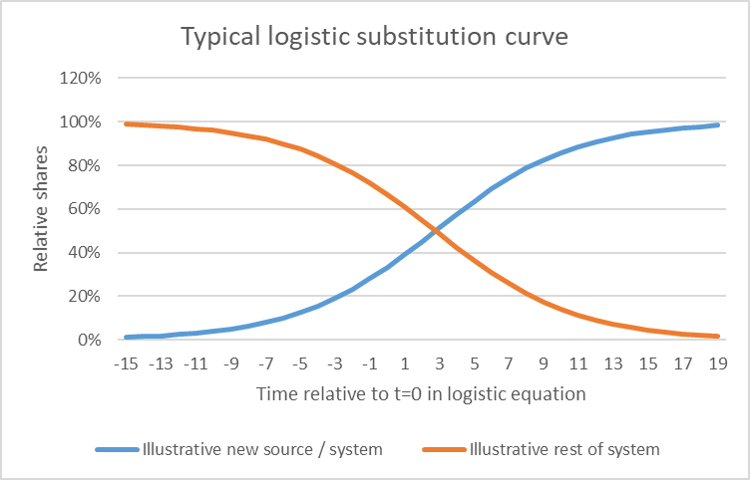
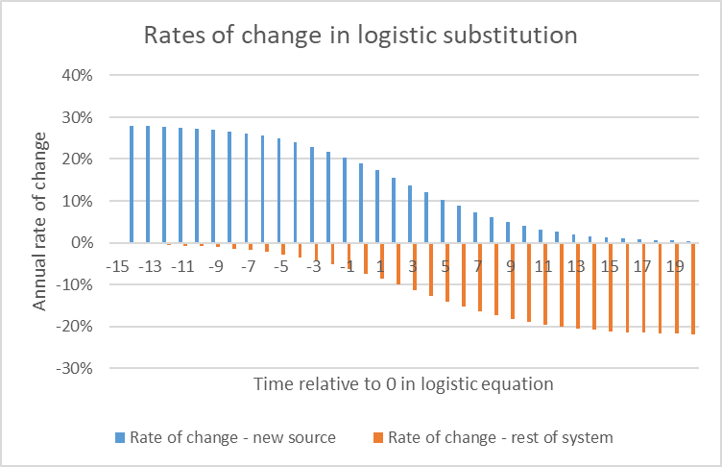
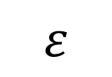
A word on context: Sectoral transformation
Need to transform energy system, transport, buildings, industry & agriculture/land use
Major sectoral transitions typically occur through “S-curve” (logistic substitution)
with self-reinforcing induced innovation
$$ε$$

Slide 22
Energy & Industrial Systems are path dependent
(c) Path Dependency
Knowledge spillovers – a documented tendency for innovations to build upon prior, related innovations in cumulative ways
Switching costs – the cost of switching to a different path eg. due to the need for different infrastructure and overcome incumbent interests
Network effects – the attractiveness of a technology depends upon interrelated networks of habituated users, suppliers and infrastructure
Positive feedbacks – when technologies benefit from scale, and adapt institutional and regulatory structures to favour incumbent industries
Complementarities – when technologies have complementary roles, such as renewables and storage, and thus develop in mutually reinforcing ways
See Aghion, P., C. Hepburn, A. Teytelboym, 2019

Slide 23
Figure 5: Path dependency – illustration
External Pressure
Default trajectory without external pressure
No path dependency (non-pliable)
Semi path dependent
Fully path dependent (pliable)
Time
Note: The slope (speed of response) reflects the inertia of the system, represented by characteristic transition time t (eq.5)

Slide 24
These are not new concepts in economics !
Schumpeterian Economics
Putty-clay modelling
Sunspot Equilibria
Many variants of endogenous tech change models
Evolutionary Economics
All of which can be, to an important degree, consistent with the fundamentals of General Equilibrium Theory (see the SMD critique) – but not the way it has been interpreted in most Integrated Assessment / “C”GE models

Slide 25
The Economics of Low Carbon Transformation
Preface: science perspectives on climate risks
Part 1: The Stylised global economics of climate change
The standard model and critiques
An unconventional critique
The components of dynamic realism
Inertia
Induced Innovation
Path Dependence
Formalisation and Results
Part 2: Innovation, transformation and UK’s next frontier
Energy, Climate Change and the Three Domains of Sustainable Development
@michaelgrubb9

Slide 26
‘Standard Assumptions’:
some mix of …
What is more realistic structure of the mitigation (abatement) cost?
Exogenous technology and preferences
Exogenous (often arbitrary) constraints on rates of change for new technologies
No inertia or just capital stock
Everything defined relative to a baseline, assumed to be least cost, projected for many decades (indeed often baseline is assumed to be ‘zero cost’ reference)
All mitigation assumed to be positive cost relative to this
Perfect (or stochastic) foresight
For an aggregated representation, need to build it up as:
The comparative economics of fossil fuel investment stream versus low carbon investment stream
Allowing for:
Learning in multiple forms leading to cost reductions with scale as well as time
The inertia and timescales of building up new industries, and also from accelerated decline of fossil fuel assets (premature retirement / “stranded assets”)
Additional elements of path dependence

Slide 27
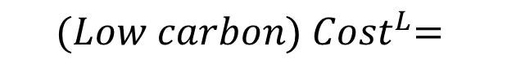

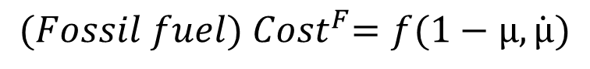
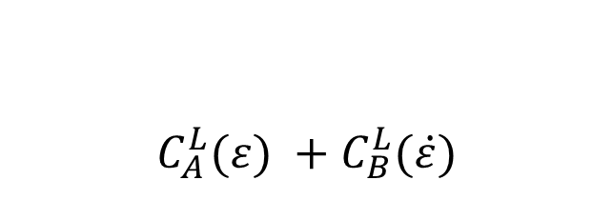
$$C_{A}^{L}(ε) +C_{B}^{L}(\dot{ε})$$
$${(Low carbon) Cost}^{L}=$$
Low carbon costs decline with learning, scale etc, but require transitional investment
$$Overall abatement μ∝\sum{εk}$$
Fossil fuel costs decline as abatement increase
.. But a transitional component increases with more rapid abatement (stranded assets)
$=C_{A}^{F}(1−μ) +{ C}_{B}^{F}(\dot{μ})$
$${(Fossil fuel) Cost}^{F}=f(1−μ,\dot{μ})$$

Slide 28
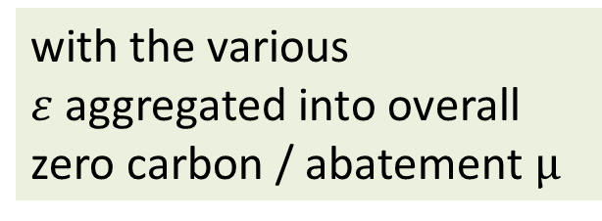
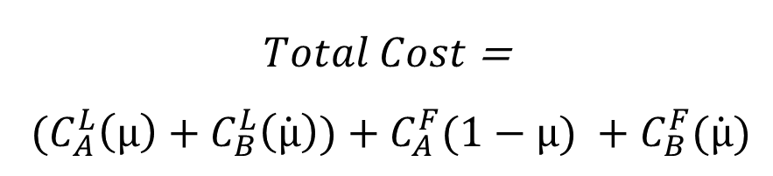
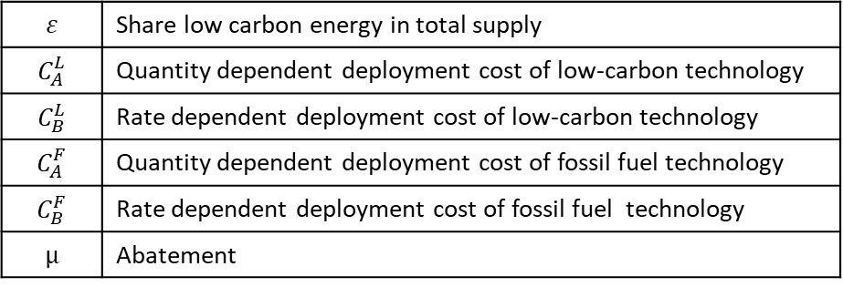
$Total Cost$ =
${ (C}_{A}^{L}\left(μ\right)+C_{B}^{L}\left(\dot{μ}\right))$ $+ C_{A}^{F}(1−μ) +C_{B}^{F}(\dot{μ})$
with the various $ε$aggregated into overall zero carbon / abatement $μ$
$$ε$$ | Share low carbon energy in total supply
$$C_{A}^{L}$$ | Quantity dependent deployment cost of low-carbon technology
$$C_{B}^{L}$$ | Rate dependent deployment cost of low-carbon technology
$$C_{A}^{F}$$ | Quantity dependent deployment cost of fossil fuel technology
$$C_{B}^{F}$$ | Rate dependent deployment cost of fossil fuel technology
$$μ$$ | Abatement
$Cost=C_{A}^{L}\left(μ\right)+C_{A}^{F}(1−μ)$ + ${ C}_{B}^{F}\left(\dot{μ}\right)$ $+C_{B}^{L}\left(\dot{μ}\right)$
Quantity dependent
Rate dependent

Slide 29
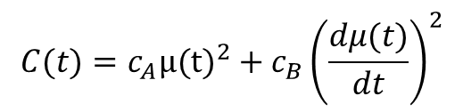
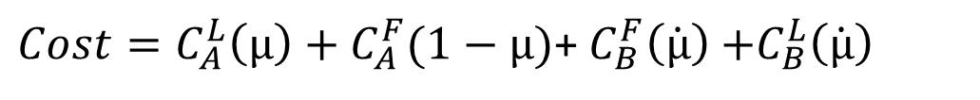
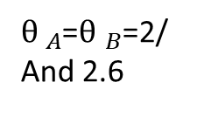
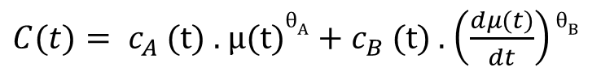
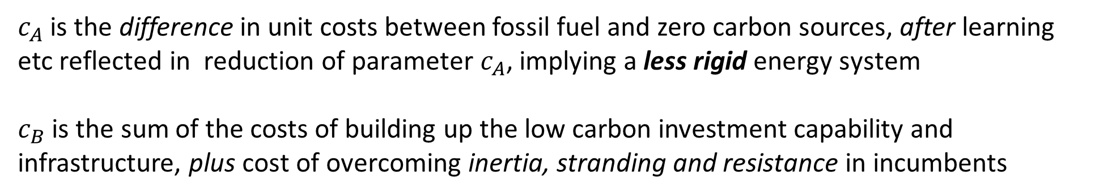
$Cost=C_{A}^{L}\left(μ\right)+C_{A}^{F}(1−μ)$+ $C_{B}^{F}\left(\dot{μ}\right)$ $+C_{B}^{L}\left(\dot{μ}\right)$
Quantity dependent
Rate dependent
In the working paper, we present evidence that all the cost functions are non-linear, likely tendency towards quadratic
$C(t)= c_{A}$(t) . μ(t)$θ_{A}$ + $c_{B}$(t) . $\left(\frac{dμ(t)}{dt}\right)$ $θ_{B}$
Abatement cost function with DICE-like rigid abatement cost plus transitional cost component
${θ }_{A}$=${θ }_{B}$=2/
And 2.6
$$C(t)=c_{A}{μ(t)}^{2}+c_{B}{\left(\frac{dμ(t)}{dt}\right)}^{2}$$
$c_{A}$ is the difference in unit costs between fossil fuel and zero carbon sources, after learning etc reflected in reduction of parameter $c_{A}$, implying a less rigid energy system
$c_{B}$ is the sum of the costs of building up the low carbon investment capability and infrastructure, plus cost of overcoming inertia, stranding and resistance in incumbents

Slide 30
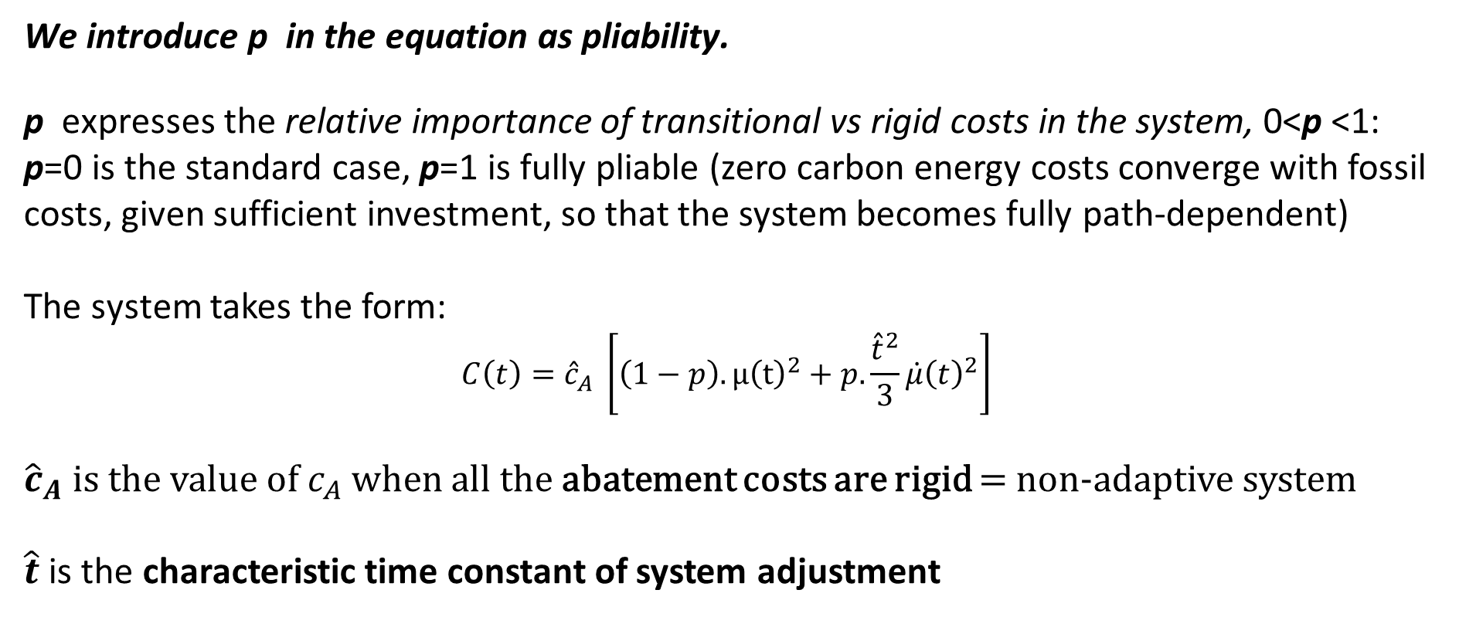
We transform this in terms of the typical transitional timescales and pliability of the system
We introduce p in the equation as pliability.
p expresses the relative importance of transitional vs rigid costs in the system, 0<p <1:
p=0 is the standard case, p=1 is fully pliable (zero carbon energy costs converge with fossil costs, given sufficient investment, so that the system becomes fully path-dependent)
The system takes the form:
$$C\left(t\right)={\hat{c}}_{A} \left[\left(1−p\right).{μ\left(t\right)}^{2}+p.\frac{{\hat{t}}^{2}}{3}{\dot{μ}\left(t\right)}^{2}\right]$$
${\hat{c}}_{A}$ is the value of $c_{A}$ when all the abatement costs are rigid = non-adaptive system
$\hat{t}$ is the characteristic time constant of system adjustment

Slide 31
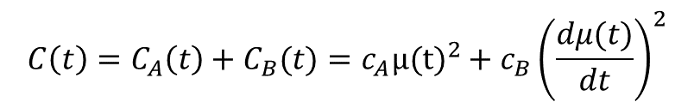
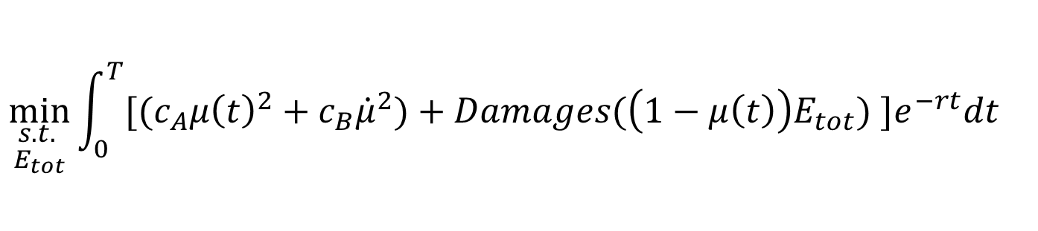

To explore optimal paths with the opposite cases, and combinations thereof:
Non-pliable (rigid) system: Enduring abatement cost only (no transitional cost): cost related to level of zero carbon source No inertia Not pliable | Fully pliable system: Transitional abatement cost only (no enduring cost): cost related to rate of zero carbon expansion. Inertia / transition costs dominate Fully pliable
$$C\left(t\right)=C_{A}\left(t\right)+C_{B}(t)=c_{A}{μ(t)}^{2}+c_{B}{\left(\frac{dμ(t)}{dt}\right)}^{2}$$
$$C\left(t\right)=C_{A}\left(t\right)+C_{B}(t)=c_{A}{μ(t)}^{2}+c_{B}{\left(\frac{dμ(t)}{dt}\right)}^{2}$$
Including a damage function …
$$\min_{\begin{aligned}s.t. \\ E_{tot}\end{aligned}}{\int_{0}^{T}{[{(c}_{A}{μ\left(t\right)}^{2}+c_{B}{\dot{μ}}^{2})+Damages(\left(1−μ\left(t\right)\right)E_{tot}) ]e^{−rt}dt}}$$
Plausible forms yield a tractable quartic equation;
we can also just insert into DICE => DICE-PACE
For further details see EPRG working paper 1808: https://www.eprg.group.cam.ac.uk/wp-content/uploads/2018/03/1808-Text.pdf

Slide 32
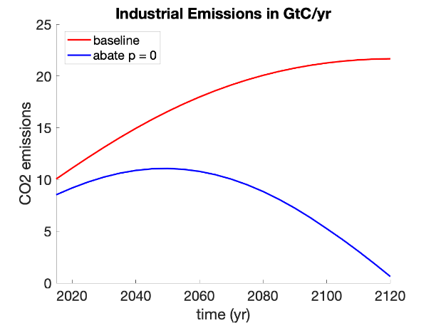
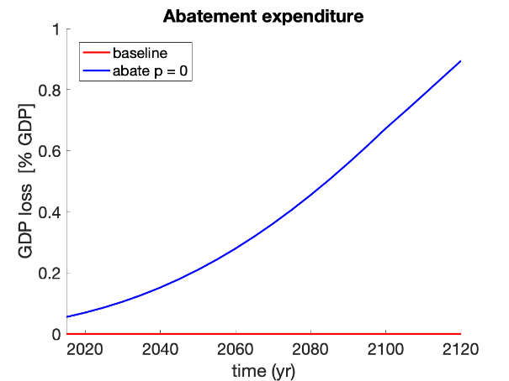
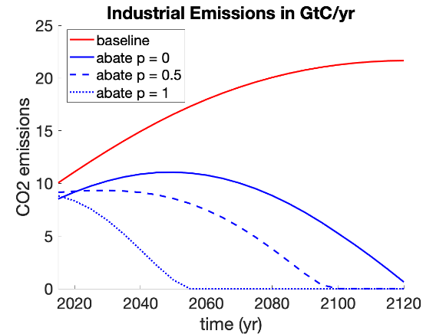
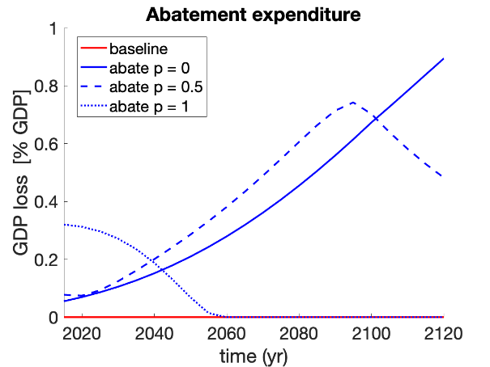
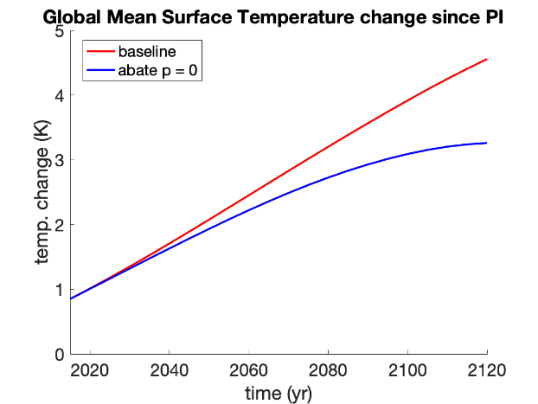
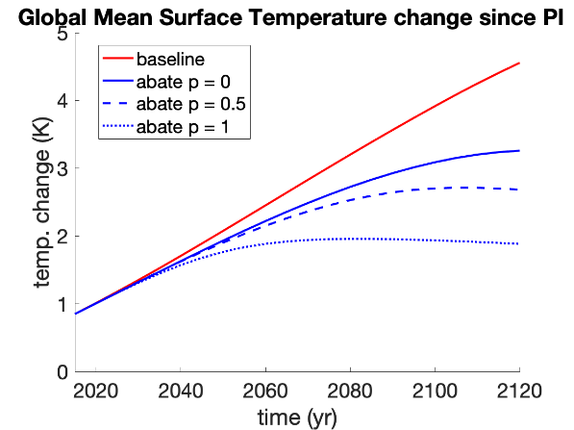
(a) System behaviour
(a) System behaviour with pliability & ch. timescale t=20
Impact of system pliability and adjustment timescales on global abatement expenditure, emissions and temperature change in DICE-PACE.
With high pliability and relatively short ‘half life’ characteristic transition time, the optimal response comprises:
Abatement: approx. linear reduction, to near zero around mid-Century
Effort: about four times bigger than in classical case (> 0.3% GDP)
Outcome: instead of > 3 deg.C, stays under 2 deg.C global temp change
Source: Grubb and Weiners (2019), Modelling Myths: On the need for dynamic realism in DICE and other equilibrium models of global climate mitigation, in review at Wiley Interdisciplinary Reviews (WIRES) – Climate Change

Slide 33
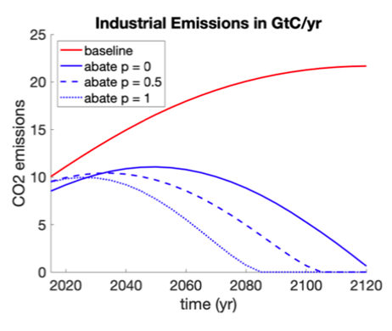
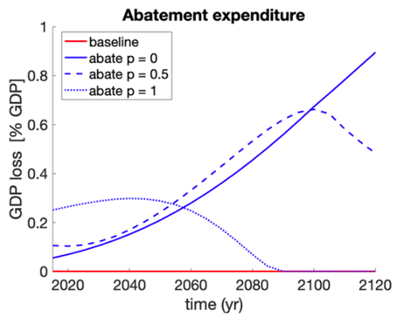
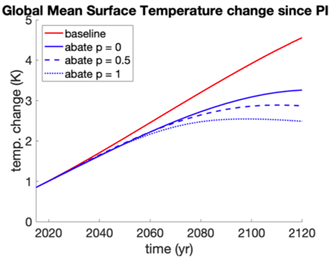
(b) System behaviour with characteristic timescale t=40 years years
(a) System behavior with characteristic timescale t=40 years
Impact of system pliability and adjustment timescales on global abatement expenditure, emissions and temperature change in DICE-PACE.
Source: Grubb and Weiners (2019), Modelling Myths: On the need for dynamic realism in DICE and other equilibrium models of global climate mitigation, Submitted to Wiley Interdisciplinary Reviews (WIRES) – Climate Change

Slide 34
Part 1: Conclusions
Standard ‘integrated assessment’ models imply sharply rising costs – both damages and mitigation costs - over the century
In reality, overwhelming evidence of induced innovation and capacity of energy technologies and systems to adapt in response to policies and external forces (“pliability”)
But coupled with high inertia – several decades for major transitions
Models with temporal independence are ‘modelling myths’: economics must consider dynamic realities. Including these:
‘Optimal’ response does not just depend on assumed scale and non-linearity of impacts and discount rate! Also depends on inertia, induced innovation and overall pliability of emitting systems
Pliability is a major driver of the net benefits of early action
Will vary by specific options and would justify diversity in apparent mitigation costs
The combination can lead to ‘cost benefit’ effort levels similar to a risk-averse strategy dominated by non-linearly / threshold assumptions, may almost stabilise gross costs

Slide 35
The Economics of Low Carbon Transformation
Preface: science perspectives on climate risks
Part 1: The Stylised global economics of climate change
The standard model and critiques
An unconventional critique
The components of dynamic realism
Inertia
Induced Innovation
Path Dependence
Formalisation and Results
Part 2: Innovation, transformation and UK’s next frontier
Energy, Climate Change and the Three Domains of Sustainable Development
@michaelgrubb9

Slide 36
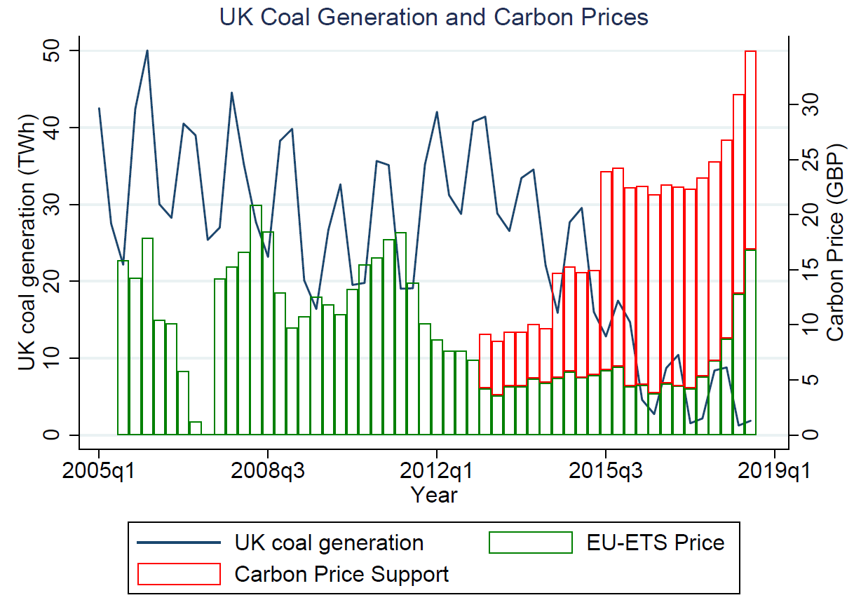
UK: an ‘island of coal in a sea of oil” no longer
UK electricity – carbon pricing and the demise of coal
UK power sector emissions halved since 1990, coal now below 10% of generation.
C price drives operation and closure not new investment or efficiency. Impact since 2014 much bigger than before due to price+ and :
Lower gas – coal price differential
energy efficiency policies, demand declining since c. 2010
Rapidly rising share of renewables
April 2017 - first hours without coal power for over a Century, driven by rising carbon price, declining gas price, and increasing renewables and efficiency.
UK total CO2 emissions now lower than a century ago, all coal to be closed by 2025
Notes:
Lecture 8 master

Slide 37
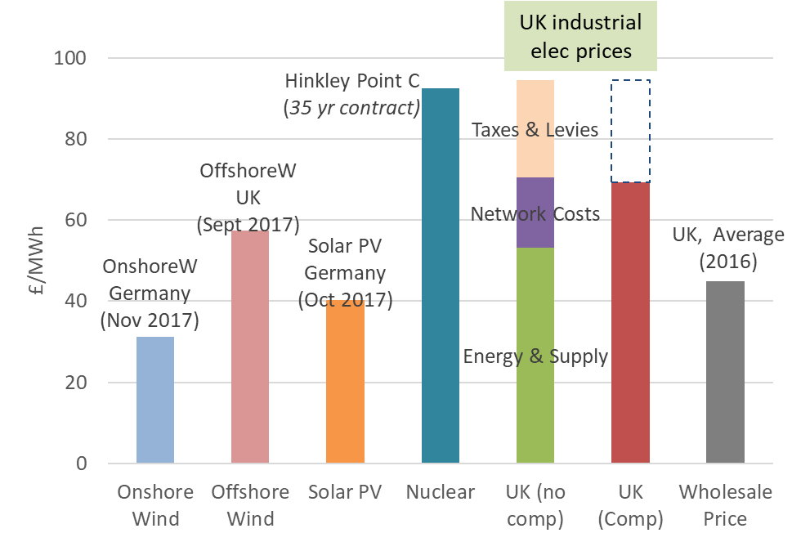
The UK’s biggest energy resource discovery..
Economic scepticism followed by huge gains from auctions & pan-European industrial development of offshore wind
tech learning, scale & supply chain economies, business confidence
=> … now < half industrial elec prices close to wholesale price
£160
Negotiated Contracts
£140
£120
First Auction
Strike Price (£/MWh)
£100
Sources: M.Grubb and D.Newbery (2018), ‘UK Electricity Market Reform and the Energy Transition: Emerging Lessons’, MIT-CEEPR working paper; Updated
Grubb & Drummond (2018), UK Industrial Elec Prices, UCL/Aldersgate Group
£80
prices reduce two thirds
prices halve
£60
Second Auction
Third Auction
£40
Third Auction
£20
£0
Allocation / auction rounds
Delivery (to first generation)
2013/14
2015/16
2017/18
2019/20
2021/22
2023/24
# Emerging as a UK and North European resource as large and valuable as North Sea Gas
Notes:
18-03 UK Energy Market Reform - Outline and lessons

Slide 38
Successful innovation must span a complex multi-domain journey
Basic R&D
Technology
RD&D
Demonstration
Commerciali-
zation
Market
accumulation
Wide
diffusion
Technology
journey
Organisation & supply chain
1 or 2
individuals
Venture or new unit
First outsiders
Recruit specialists,
Develop
supply chain
Grow operational staff
Mature
company or
independent
division
1st
Customers and standards
No market
defined
first
targeting of
possible markets
Choosing
Market of
commercial-
ization
Early adopters
and niches,
basic standards
Expanding
range of
customers
Well defined
customer
Profile,
trusted brand
Public or
Internal
funding
Internal funds
or
project
grants
Internal funds,
project grants,
angel or VC
investors
First sales,
internal or
external funds
still needed
First profits
Financing
through
private equity,
banks, etc.
Source: Grubb, McDowell and Drummond (2017), On order and complexity in innovations systems, Energy Research & Social Science; derived from Fig.9.8 in Grubb et al (2014) Planetary Economics
Financing
Growing social scale and role of higher domains
2nd
Neutral or
negative
regulation
Neutral or
negative
regulation
Neutral
regulation
Specific
positive
regulation
Positive
general
regulation
Fully adapted
regulatory
environment
Market Regulation
Research
institutions
Bespoke
tech
institutions
First sector
associations
Eg. first IPO,
licence
acquisitions
Lobbying,
corporate
expansion
Stable role of
associations
in negotiating
sector policy
Institutional
3rd
Research
infrastructure
Test centres
Negative
or neutral
‘Piggybacking’/
First enabling
infrastructure
investments
Barriers from
existing
infrastructure
Adapted or
dedicated
infrastructure
Infrastructure

Slide 39
Transition policy comprises a package …
“The EU 3-targets approach is madness.. “
“Other policies such as feed-in tariffs, industry regulation and subsidies, are far less economically preferable than carbon pricing to reduce emissions… “ (OECD, 2013)
I beg to differ …
Key is to match the best instrument to the respective domain of decision-making
Policy pillars
H
Highest relevance
1
2
3
M
Medium relevance
Domain
L
Lowest relevance
Standards & Engagement
Markets & Prices
Strategic Investment
H
M
L
L/M
H
L/M
L
M
H
‘Smarter’
individual & corporate choices
Satisfice
Optimise
Cleaner products & processes
Transform
Innovation & infrastructure
Notes:
In book order

Slide 40
Three pillar policy especially important in energy because ..
An essential good
Deep structural impediments – ‘energy efficiency gap’, little or no product differentiation, natural monopolies etc
Exceptionally low rates of private sector innovation
Historic instability of fossil fuel markets – business cycles on politicised steroids
Pervasive input to numerous production sectors
Large, global and very long timescale ‘externalities’

Slide 41
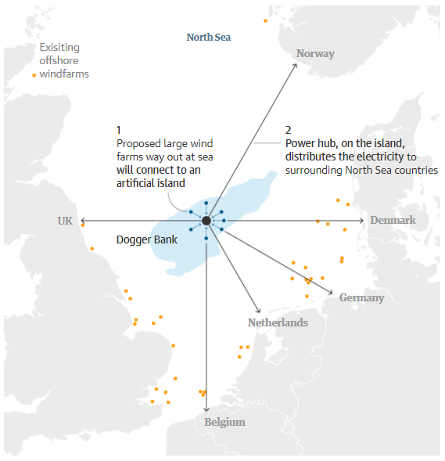
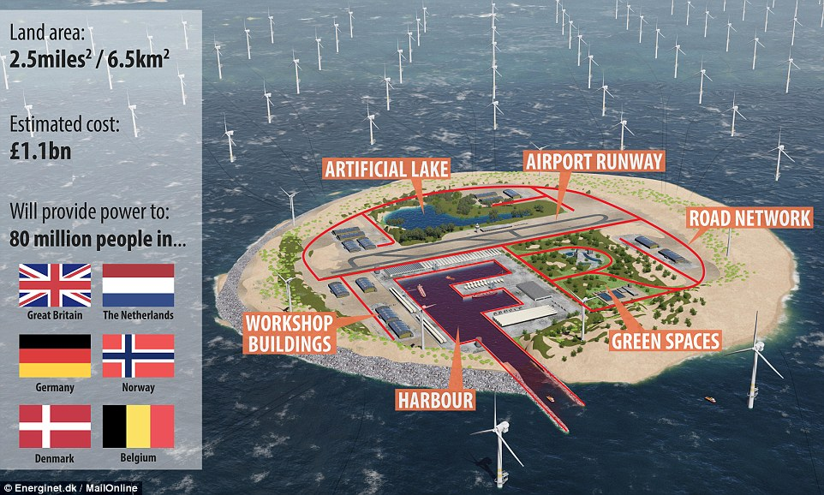
The Prize: a new North Sea Energy Renaissance
… with proposal for offshore wind based around island in Dogger Bank
- a scale, value & strategic significance on a par with North Sea gas
Source: Guardian/Tennet
Notes:
According to Tennet, the project could handle windfarms with a capacity of 30GW, more than twice today’s total installed offshore wind power across the whole of Europe.
Highlight the need for cross-country government cooperation to support such innovation

Slide 42
This cannot happen from pure markets and pricing
(Nor did North Sea oil, which enjoyed £10bn/yr investment for a decade)
There would be vast gains to European collaboration
Investment scale (learn from Hinckley Point)
Complementary skills
Transmission efficiency
Managing the variability, dispersion and backup to maximum benefit
Have we become so much market societies that we can no longer think in such terms?
Will European relations become so difficult that we can no longer find common cause to develop a resource of strategic importance to the entirety of northern Europe ..
.. And the multiple parallel global transformations?

Slide 43
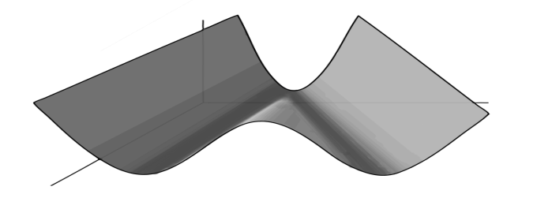

‘Ignoranti quem portum petat nullus suus ventus est’ - Lucius Annaeus Seneca
No wind is favourable to those who don't know where they are going
Clustering of ‘low cost’ energy futures around higher and lower emissions, rather than in the middle, reflects divergent responses to depletion of ‘easy oil’
Global energy costs
Annual global emissions
We are here
Time
‘Green’ futures
Integrated high-innovation system
Low-carbon, ‘smart electricity’
Biomass and electricity in transport
High capital costs….
……but low operating costs
‘Brown’ futures
Continued dependence on fossil fuels
Unconventional and synthetic oil in transport
Low capital costs…
…but high operating costs and a host of environmental issues beyond carbon
Figure 10-6: Two kinds of energy future – the carbon divide
Source: Upper panel: Gritsevskyi and Nakićenović (2000); lower panel: authors

Slide 44
.. Postscript: And there is another completely different way of concluding that optimal abatement schedule is approximately linear …

Slide 45
The Economics of Low Carbon Transformation
new theories, approaches and policies
Michael Grubb
Research Director and Professor Energy and Climate Change,
University College London (UCL) – Inst. Sustainable Resources & Energy Institute
Convening Lead Author, Intergovernmental Panel on Climate Change (IPCC) Mitigation Report Ch.1
UCL Public Lecture series on Policy and Practice
UCL Department of Economics / Department of Political Science / School of Public Policy
5th December 2019

